Slide 1
BFX_UA300 FFC cable FA report
Date : 29-Nov-2021
Prepared by: Rachel

Slide 2

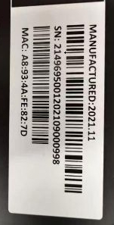
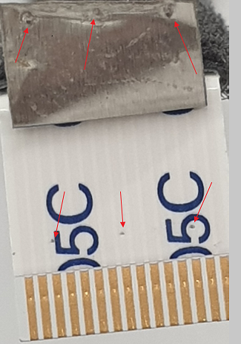
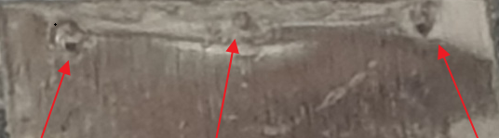
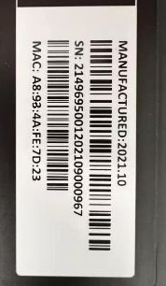
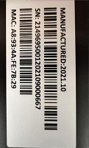
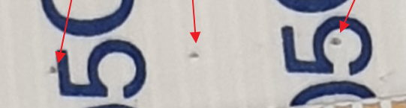
D2. Description of Problems
1. Issue Description
24-Nov-2020, ALT compliant that 3 units BFX-AU300 - FFC Cable Connection Fail .
No. | SN | Label Product | Production date | Failure Description Feedback from Customer
1 | A8934AFE827D |  | 01-Nov-2021
2 | A8934AFE7D23 |  | 18-Oct-2021
3 | A8934AFE7B29 |  | 03-Oct-2021

Slide 3
D2. Description of Problems
2. Check Customer feedback 03 units production history
No. | MAC | SN | Production Date | FFC cable | DC | Vendor
1 | A8934AFE827D | 2149695001202109000998 | 11/1/2021 10:04:37 AM | 376.00039.005 - 10 | 202140 | P-TWO
2 | A8934AFE7D23 | 2149695001202109000967 | 10/18/2021 8:57:27 AM |  | 2121.09.03
3 | A8934AFE7B29 | 2149695001202109000667 | 10/3/2021 1:34:55 AM |  | 2021.09.03
Result:
FFC P/N : 376.00039.005 – P-TWO vendor.
2. Date code is 202140 & 2021.09.03

Slide 4
D3. Containment
1. Check Customer feedback 03 units production history
Number
 | Product MAC | BT Station | PT Station | Assy 2 -> 4 | FT1 -> FT3 | RC1 -> RC2 | Packing
1 | A8934AFE827D | 11/1/2021 10:09:22 AM | 11/1/2021 10:27:47 AM | 11/2/2021 9:31:07 AM | 11/2/2021 11:09:49 AM | 11/2/2021 11:28:01 AM | 11/2/2021 4:51:22 PM
2 | A8934AFE7D23 | 10/18/2021 3:21:52 PM | 10/18/2021 3:24:24 PM | 10/19/2021 8:22:56 PM 10/20/2021 9:02:25 PM | 10/21/2021 1:01:53 AM | 10/21/2021 3:41:49 AM | 10/21/2021 8:33:08 AM
3 | A8934AFE7B29 | 10/3/2021 5:35:48 AM | 10/3/2021 10:13:16 AM | 10/4/2021 8:09:40 AM. 10/5/2021 1:35:47 AM | 10/4/2021 8:32:06 AM. 10/5/2021 2:02:37 AM | 10/4/2021 9:46:38 AM. 10/5/2021 4:17:35 AM | 10/5/2021 8:47:08 AM
Result : Check tested data is normal, 2/3 units have repair record and open housing .

Slide 5
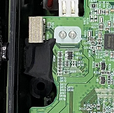
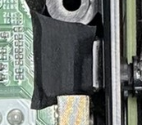
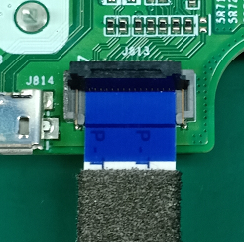
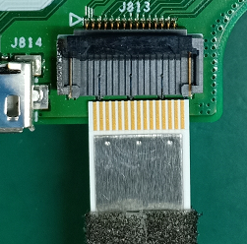
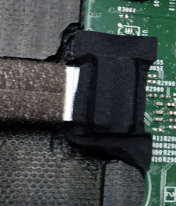
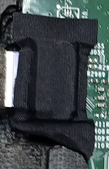
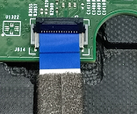
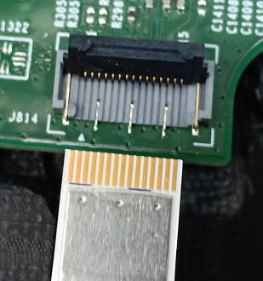
D3. Containment
3. Check Customer feedback online production
96.1531T00
K18X001T00
Result : Online production, Assy FFC cable OP doing follow SOP. No detect any FFC cable issue .

Slide 6
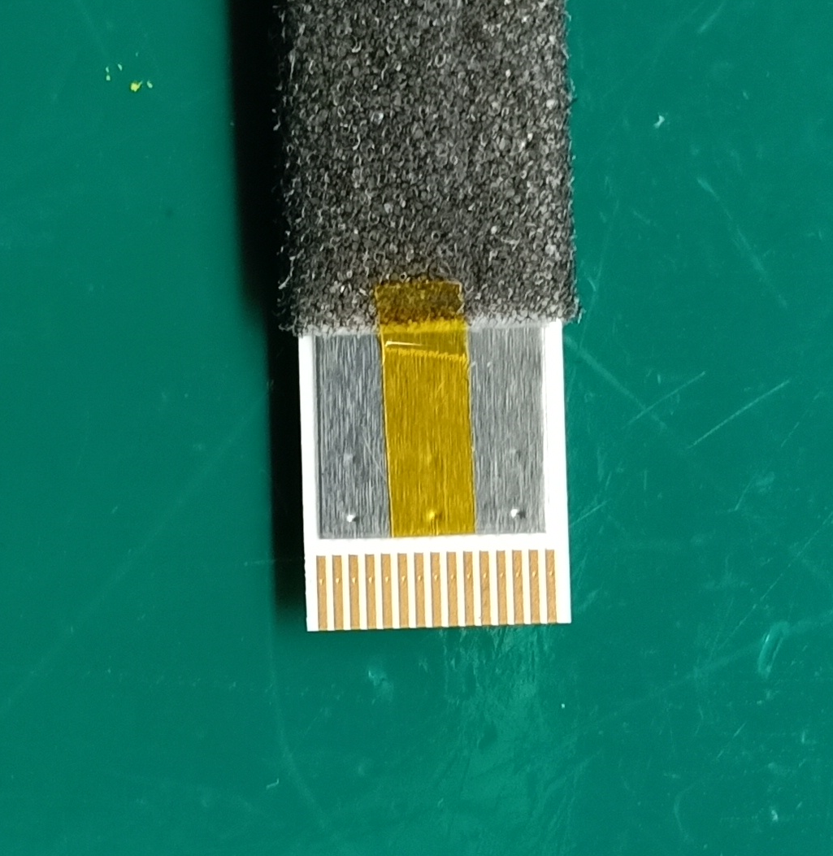

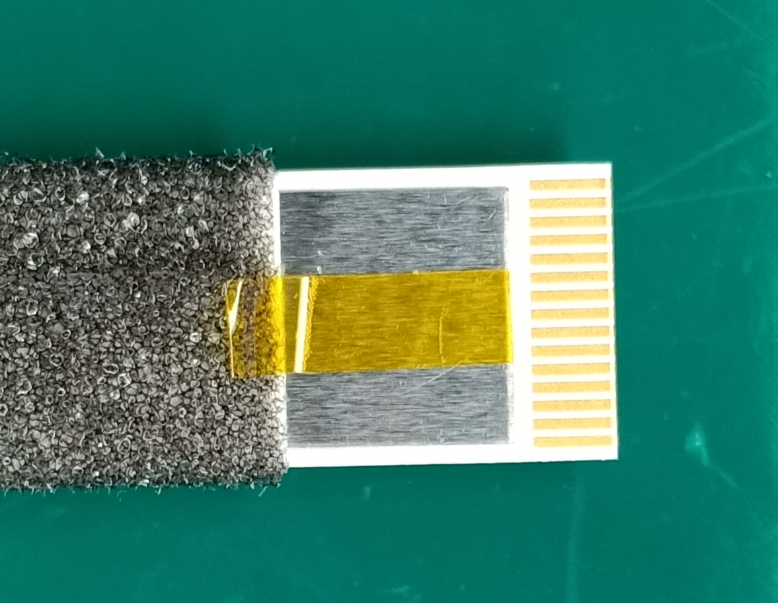
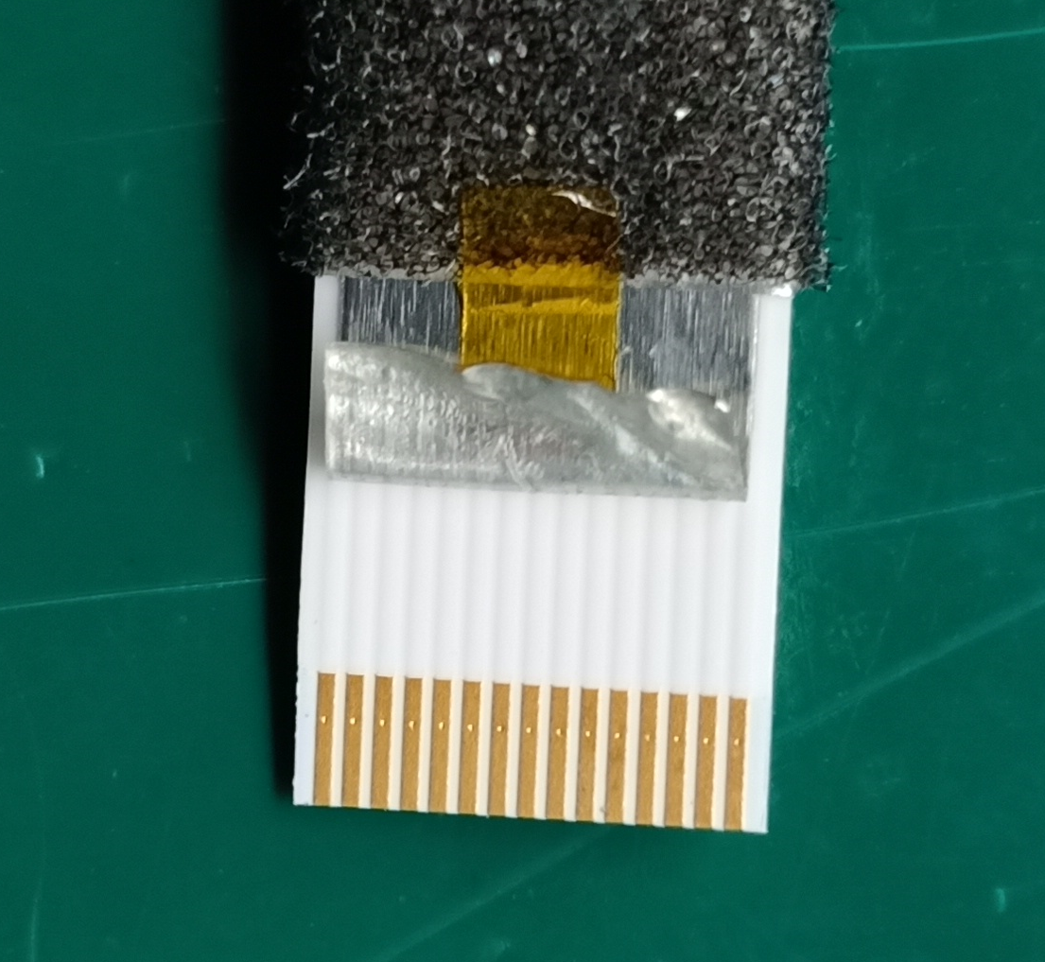
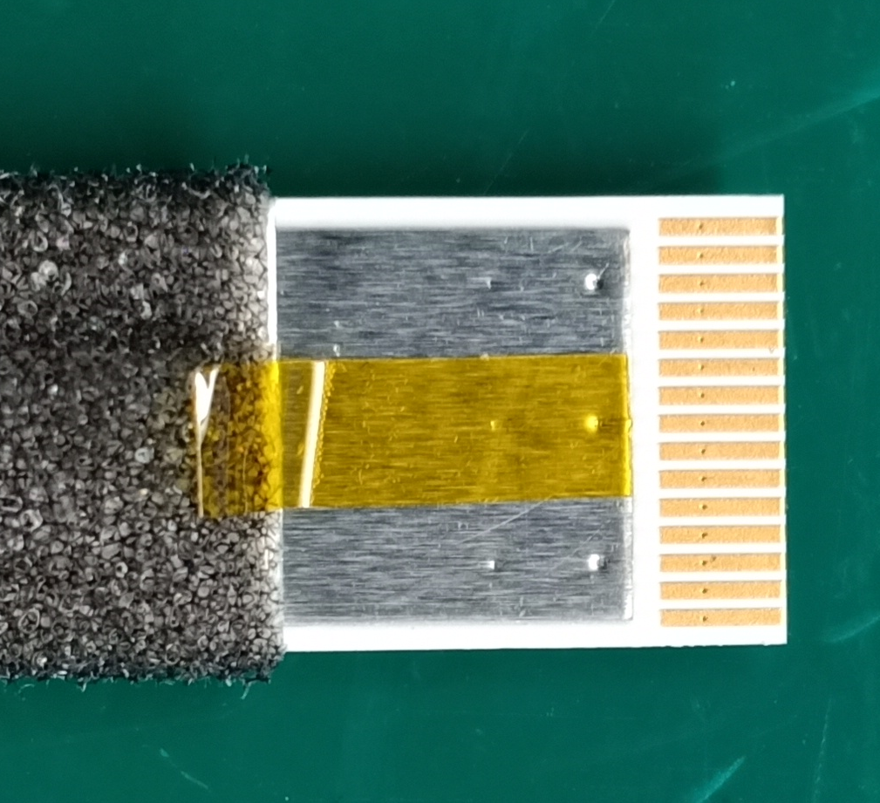
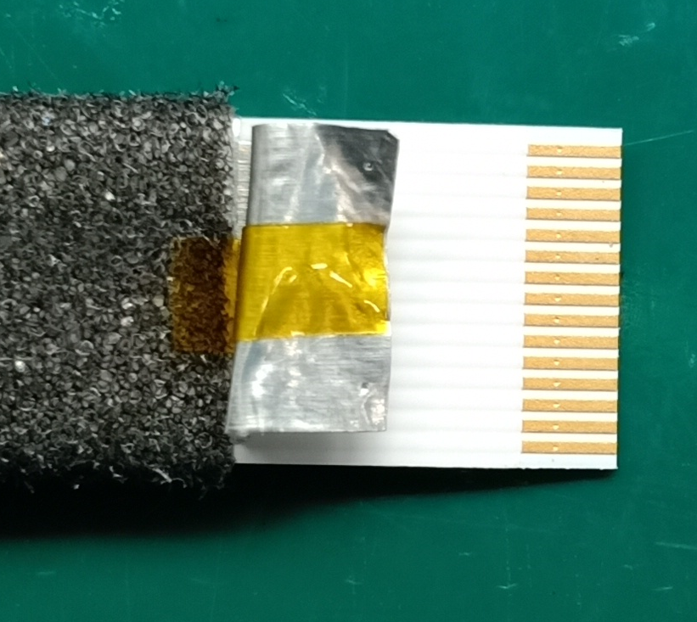
D3. Containment
4. Corrective action :
4.1 . Add more heat resistant seal protect middle pin( Short term )
Add more Add the seal(PN:A221034572101001) in middle face of FFC cable
Before
After improved
4.2. Re-assembly in 50 times to verify
Result : Didn’t have dot streaks on face FFC
After re-assembly in 50 times
Before assembly
Result : Online production, before Assy FFC cable manual doing follow SOP 100%.

Slide 7
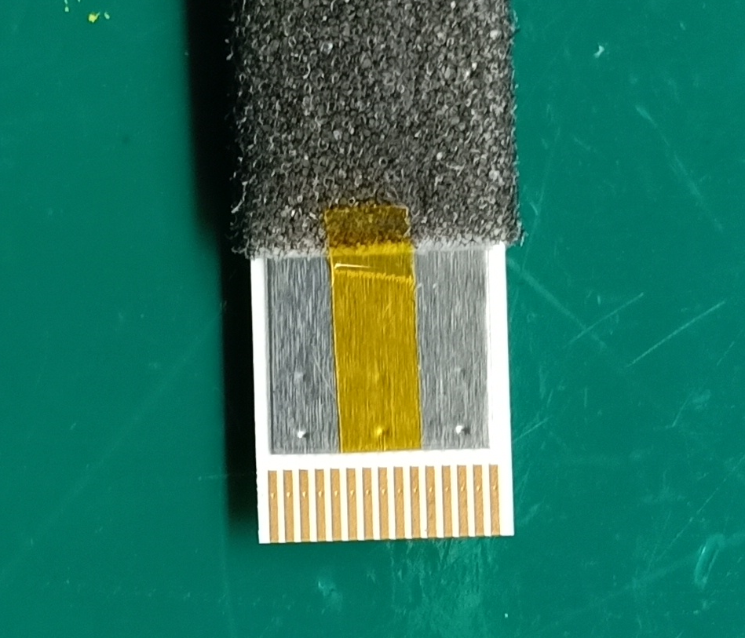




4.3 Verify 10pcs by adding the seal(PN:A221034572101001) in FFC cable from FATP to OBA station.
Add to SOP online
5. Add item visual check LED at RC1 test station ( Short term ) Done: 2011.11.27
Result :
- Add the seal in FFC cable ➔ No find out FFC cable short issue
- Add item visual check LED at RC1 station , No found any abnormal issue.

Slide 8
Summary
Online product doing follow SOP.
Function test no defect any FFC cable short issue .

